Slide 1
Cost of Living Analysis
Using PowerBI

Slide 2
Introduction
Objective: To analyze the cost of living across various global cities.
Scope: Includes metrics such as housing costs, food prices, transportation costs, and more.
Data Source: Dataset containing cost of living information for 4956 entries across multiple cities and countries.

Slide 3
Overview
Dataset Summary:
Total Entries: 4956
Total Columns: 58
Cities Covered: [Number of unique cities]
Countries Covered: [Number of unique countries]
Key Variables :
City
Country
Cost metrics
Data Quality Indicator

Slide 4
Tools Used
Microsoft Excel
Power BI

Slide 5
Steps Involved
Data Cleaning and Preprocessing
Exploratory Data Analysis
Visualization and Insights Extraction

Slide 6
Key Insights
Metropolitan and capital cities tend to have a higher cost of living.
Significant differences in housing and food costs across different regions.
Cost of living is generally higher in developed countries compared to developing countries.

Slide 7
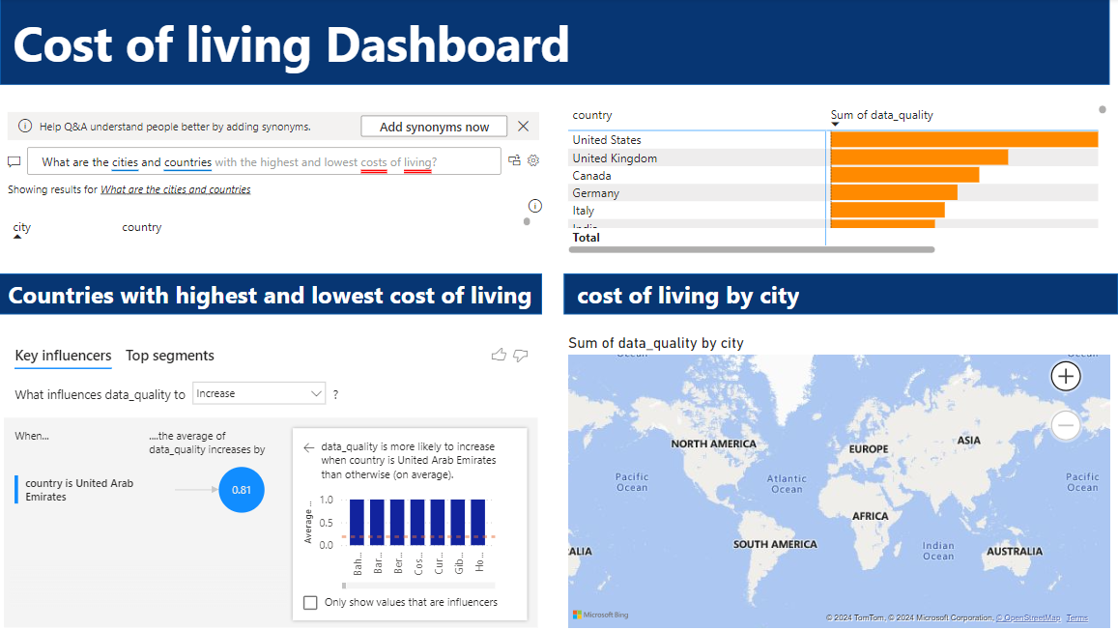

Slide 8
Thank you

